Slide 1

Roger McDaniels
Session 4 – Green/Yellow Group

Slide 2
Weekend Classroom Agenda
Session 1
  You, your weekend and your goals
Session 2
  Understeer & oversteer - Theory
Session 3
  Understeer & oversteer - Practice
Session 4
  Visual Cues
Session 5
  On track exercise review and discussion
Session 6
  You, your weekend and your goals review
Notes:
2

Slide 3
Why Are You Here?
Precise and Consistent
  Improve Control
    Increase Confidence
      Safety
      Fun
      Speed
Notes:
3

Slide 4
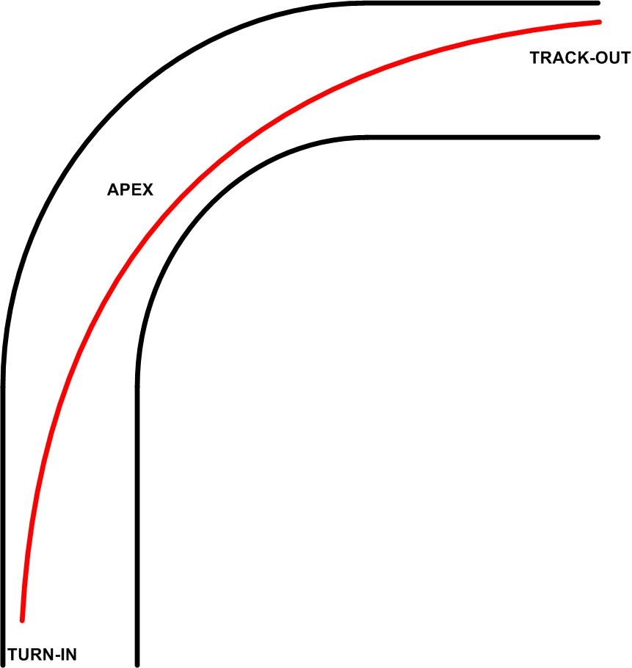
The Racing Line – Why?
Notes:
-We’re not racing, that’s just what it’s called
-Straight lines are faster than turns
carrying speed in corner, minimizing severity of turn
-This is a geometric line. It may not be the best line, which can depend on a number of factors, car, driver, conditions, strategy, etc. Check with instructors, look at what others are doing, try different lines.
4

Slide 5
What happens when we get it wrong?
Turn in too early (common with less experienced drivers)?
Turn in too late?
Not at track edge for turn-in (too common, even in advanced groups)?
Apexing too far from edge of track
Notes:
Overview slide, specific scenarios covered on subsequent slides
5

Slide 6
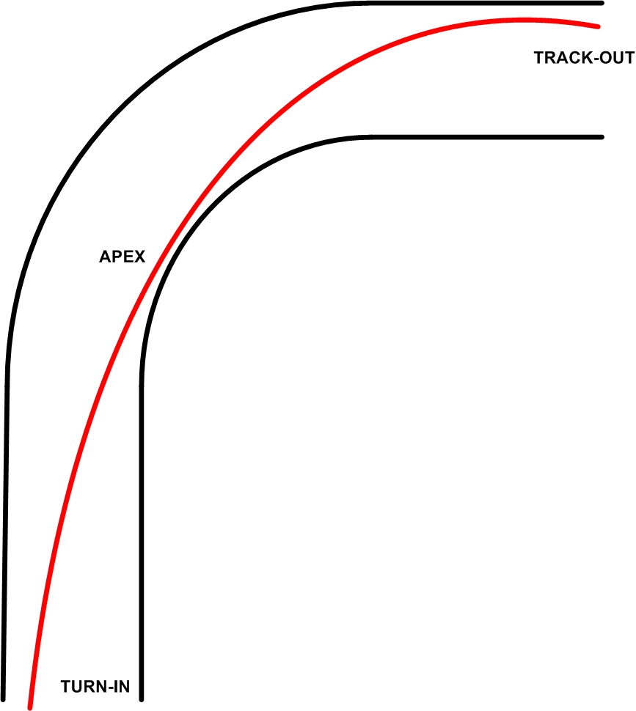
Too Early
Notes:
Carry a lot of speed in, then run out of track, have to slow/scrub to make turn, “fast-in/slow-out”
6

Slide 7
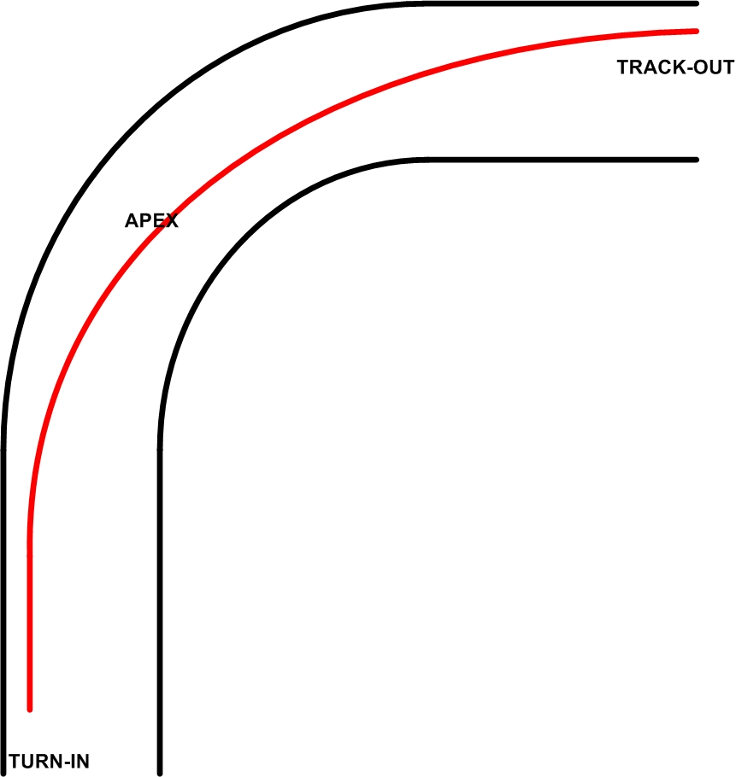
Too Late
Notes:
May have to slow/scrub to make the turn-in, doesn’t carry much speed, miss the apex, can feel fast because you are on throttle early, but noise does not equal speed
7

Slide 8
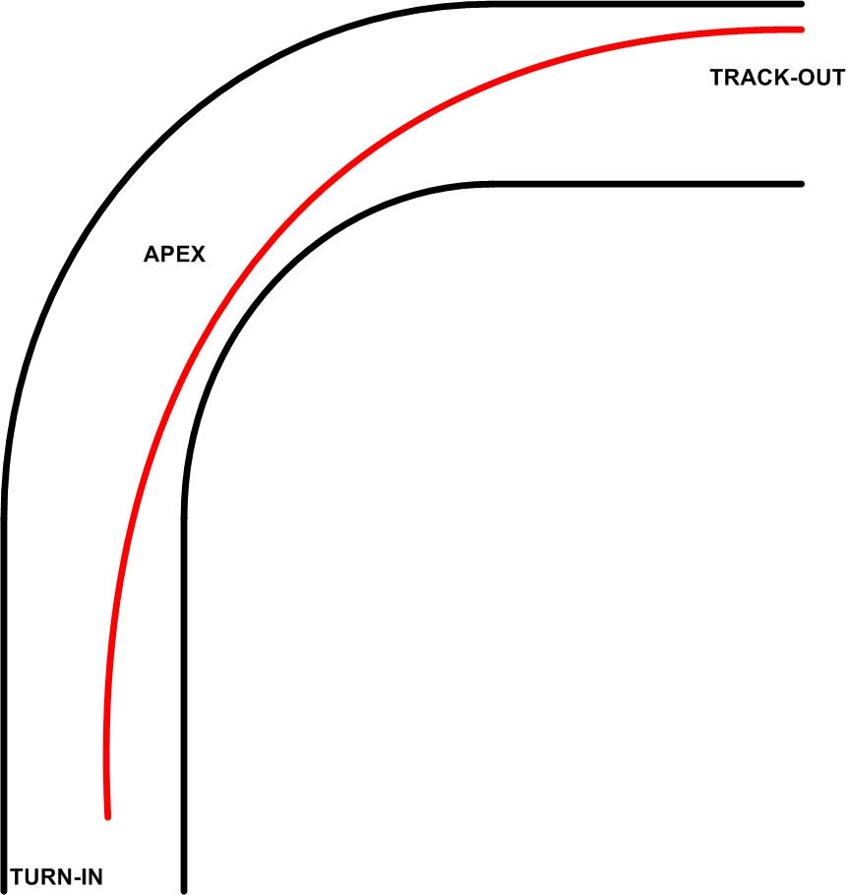
Center Track
Notes:
More subtle difference, but line is curved more sharply than geometric line, so carries less speed. Can happen if driver is looking ahead (which is good), but not situationally aware of where they are on track (which is not so good).
8

Slide 9
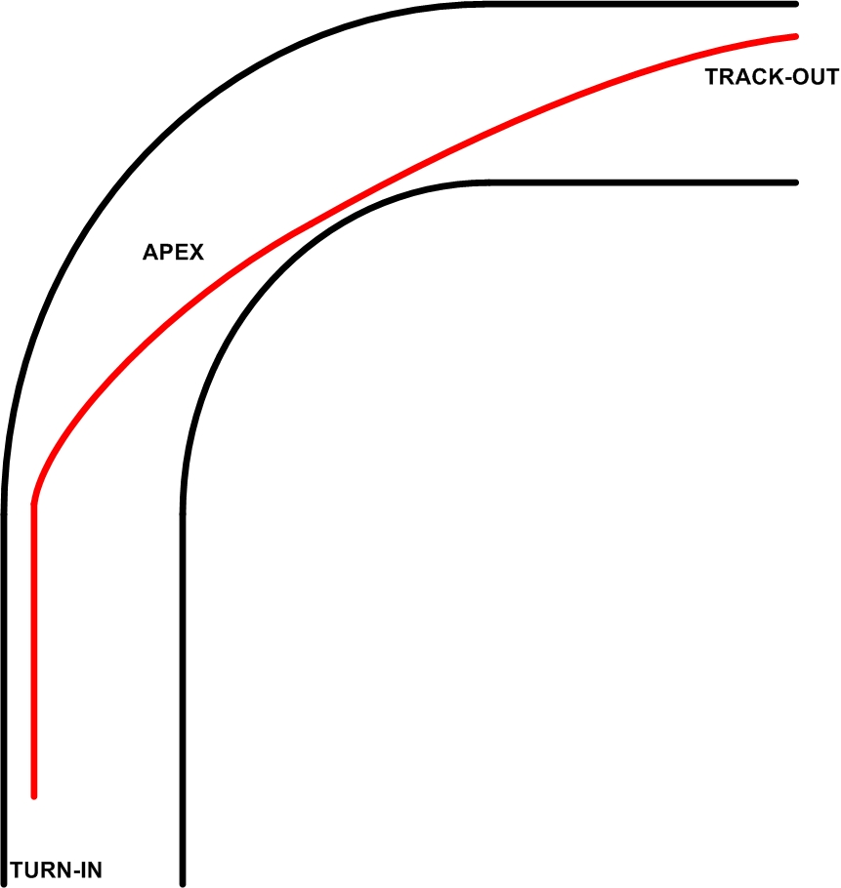
Late Apex
Notes:
Slow-in, fast-out. May be faster, especially in higher-powered cars. Will require weight-transfer skills (trail braking) to maintain entry speed. Discuss risk/reward of trail braking (reinforce that students always consult their in-car instructor before trying anything). Will be harder on tires, brakes, engine.
9

Slide 10
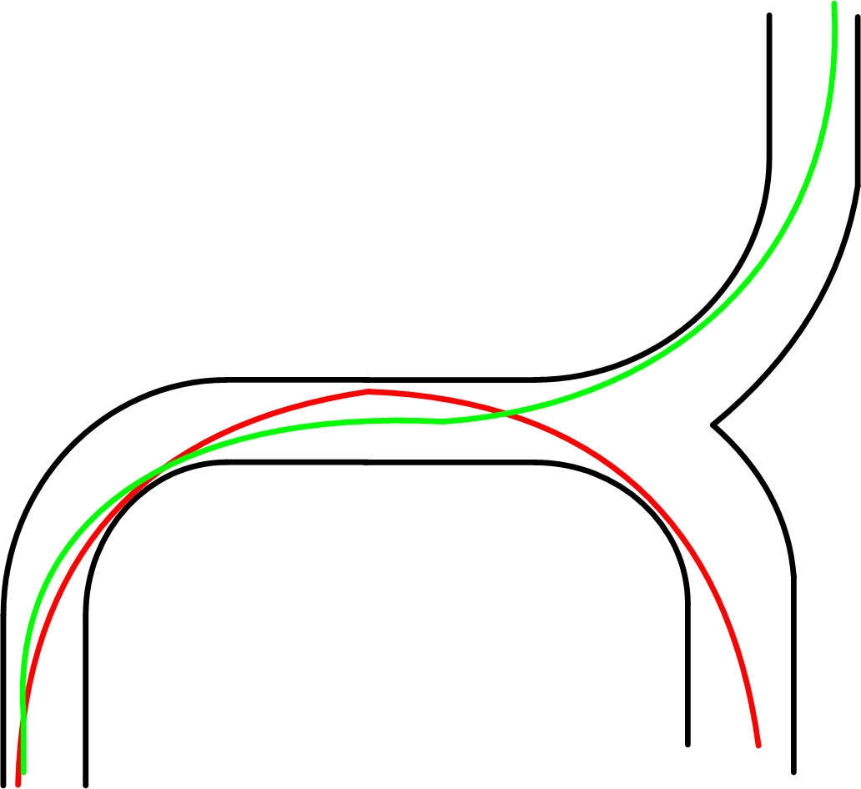
It Depends
Notes:
Your line depends on what is next.
10

Slide 11
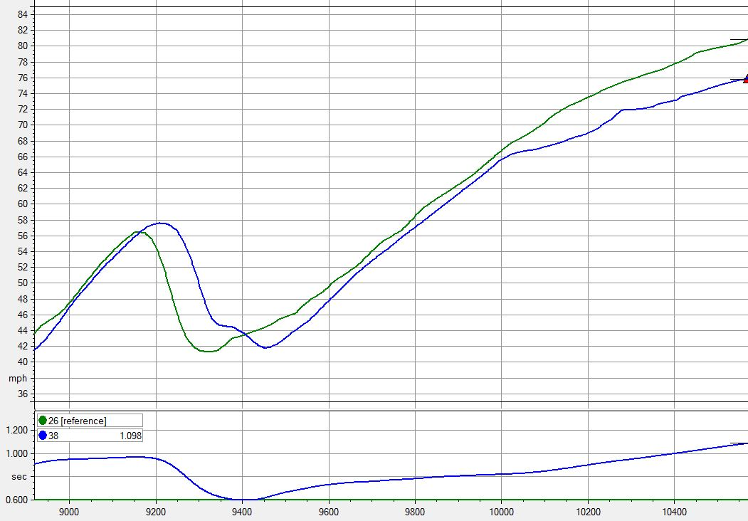
The turn before the straight
Notes:
Slow-in/fast-out wins; the longer the straight, the more it wins. Talk a bit about data acquisition.
11

Slide 12
Where do you turn in for T1?
Notes:
Ask around, see if I can get some answers. If they know this one, then ask about T3, T4, T6, T8, etc.
12

Slide 13
Movie Time
Notes:
Step through a lap of CMP, go frame-by-frame through the turns and look for visual input timing cues.
13

Slide 14
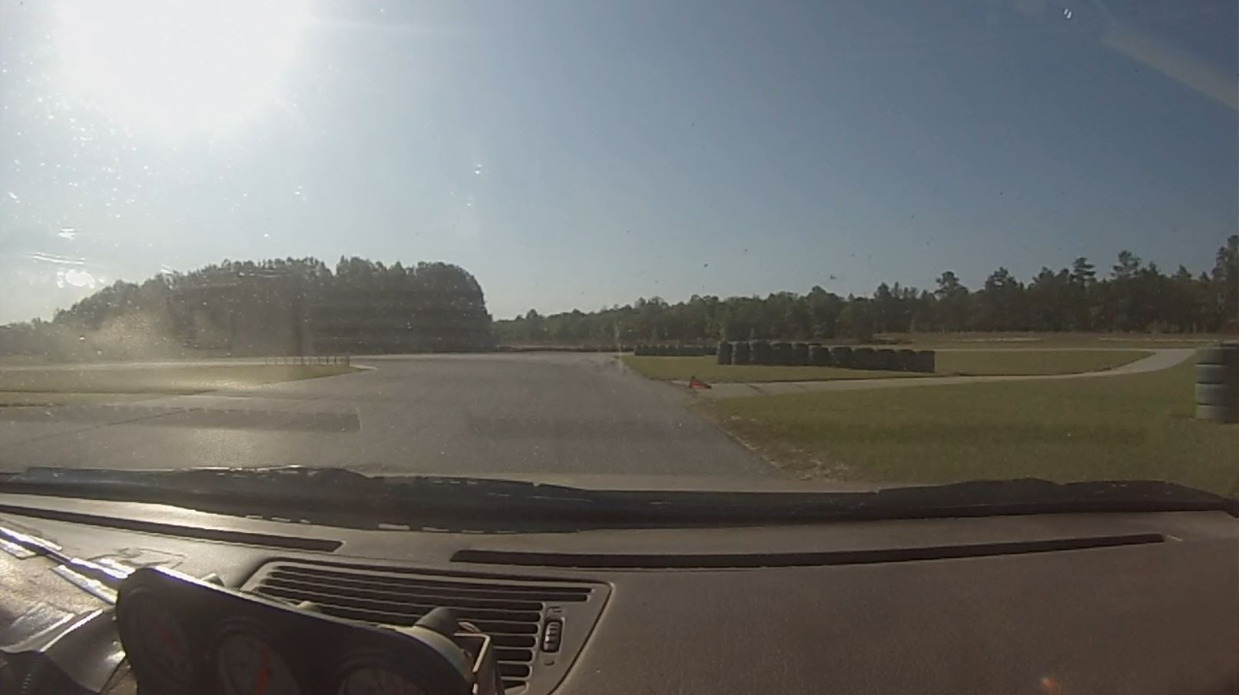
T1
Notes:
Pics of the turns. You should be able to cover this in the video, but just in case, here are some still pics.
14

Slide 15
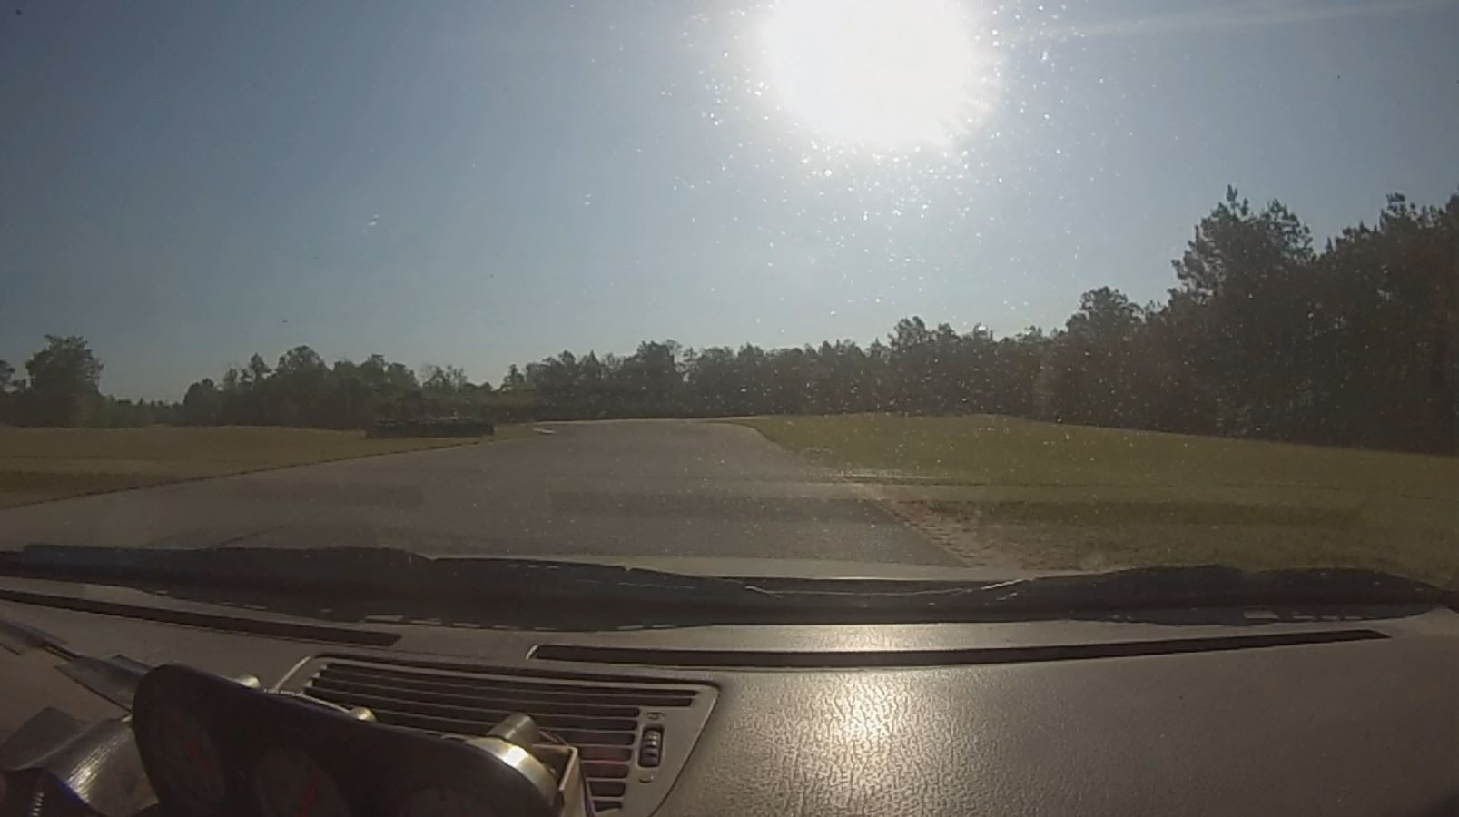
T3
Notes:
Pics of the turns. You should be able to cover this in the video, but just in case, here are some still pics.
15

Slide 16
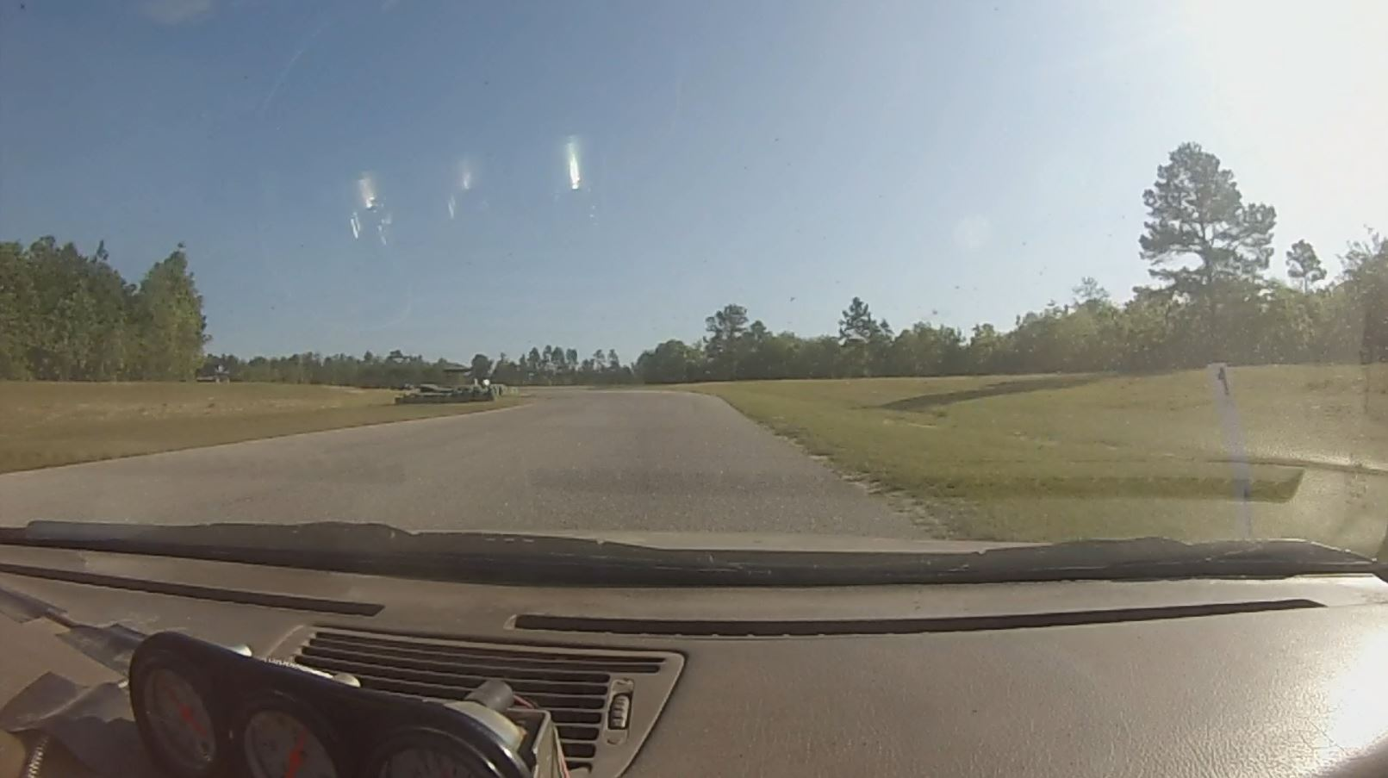
T4
Notes:
Pics of the turns. You should be able to cover this in the video, but just in case, here are some still pics.
16

Slide 17
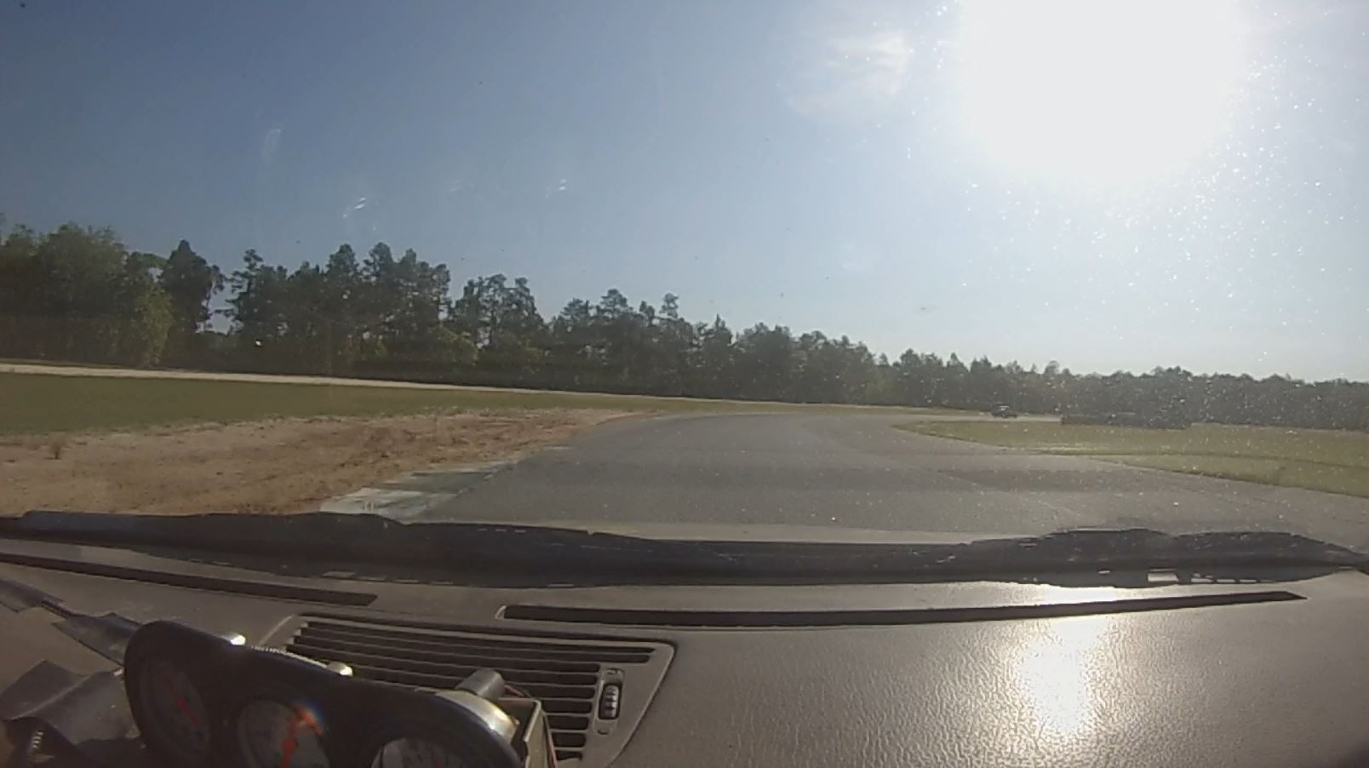
T6
Notes:
Pics of the turns. You should be able to cover this in the video, but just in case, here are some still pics.
17

Slide 18
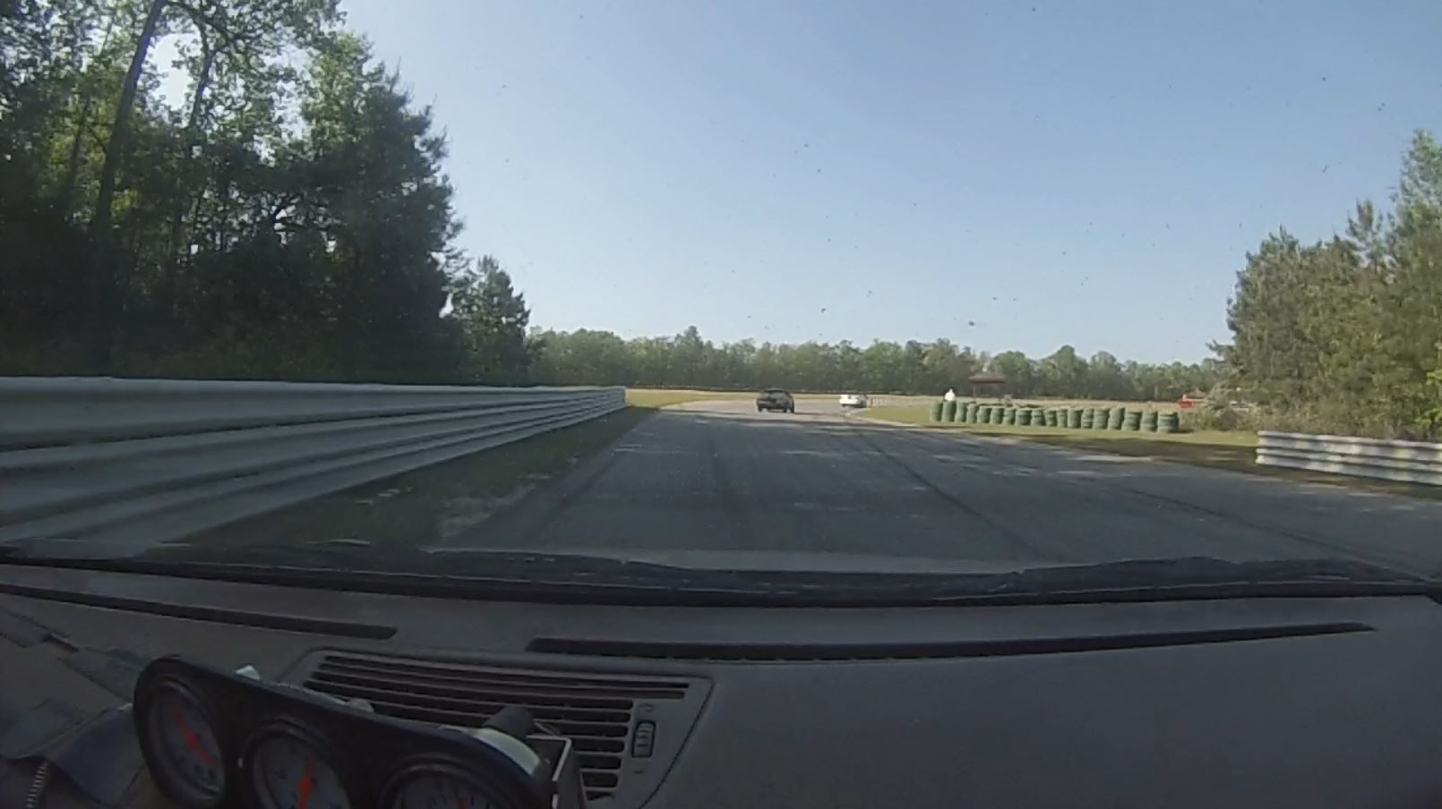
T8
Notes:
Pics of the turns. You should be able to cover this in the video, but just in case, here are some still pics.
18

Slide 19
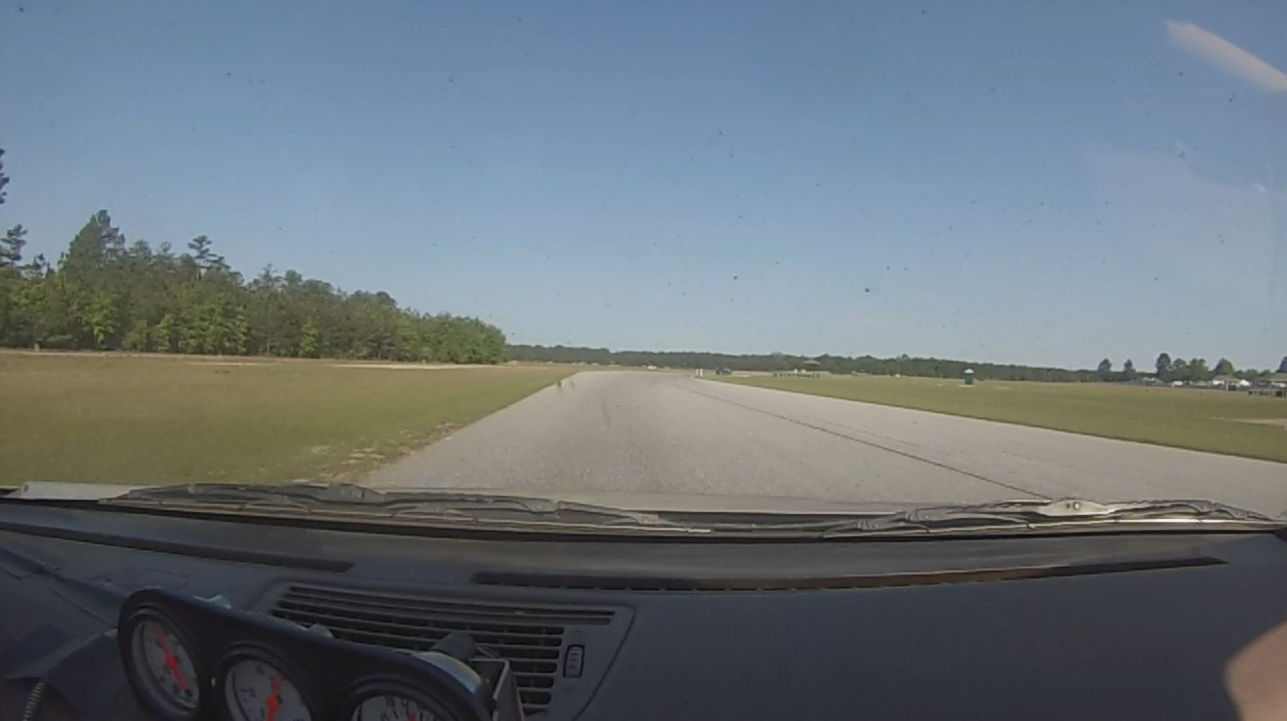
T10
Notes:
Pics of the turns. You should be able to cover this in the video, but just in case, here are some still pics.
19

Slide 20
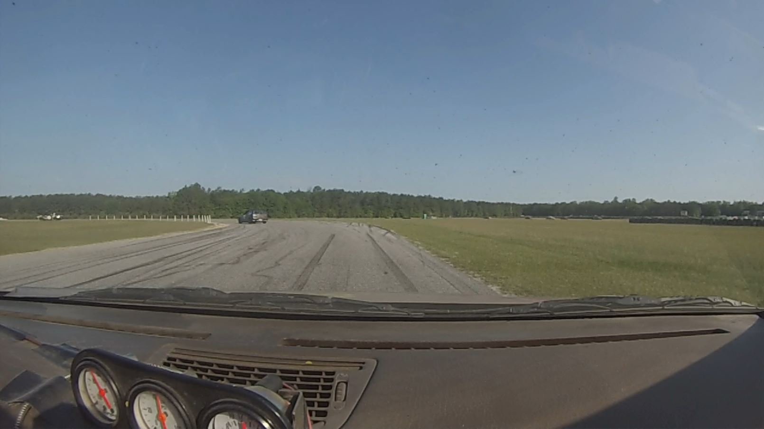
T11
Notes:
Pics of the turns. You should be able to cover this in the video, but just in case, here are some still pics.
20

Slide 21
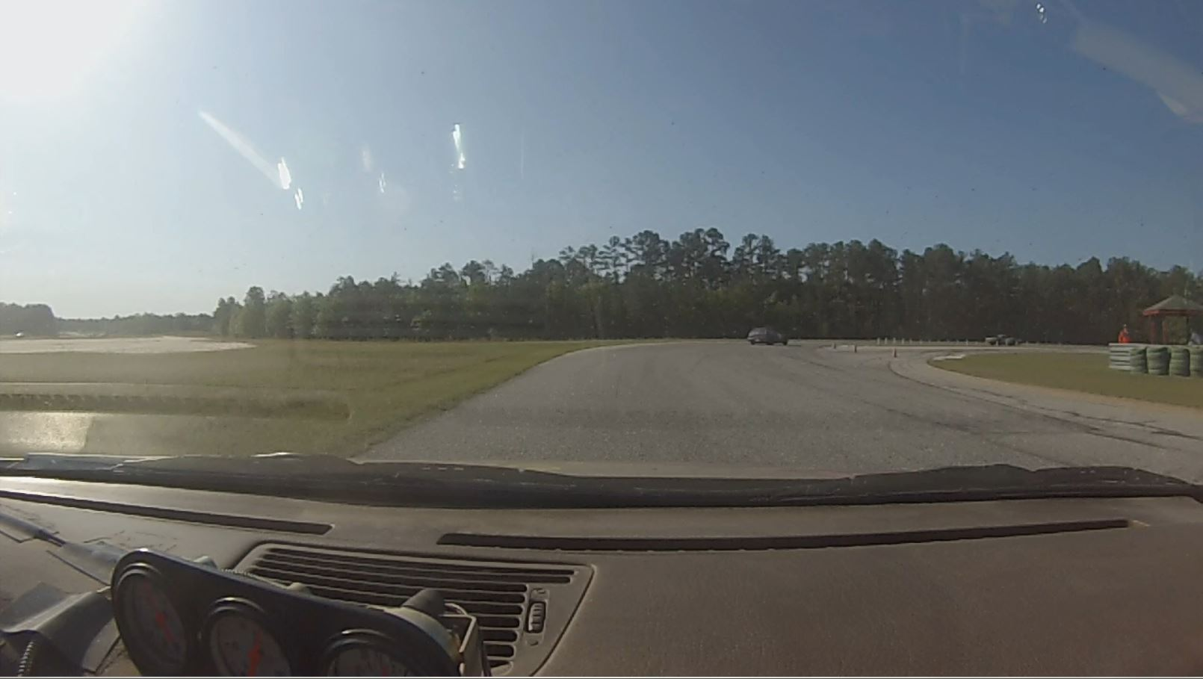
T12
Notes:
Pics of the turns. You should be able to cover this in the video, but just in case, here are some still pics.
21

Slide 22
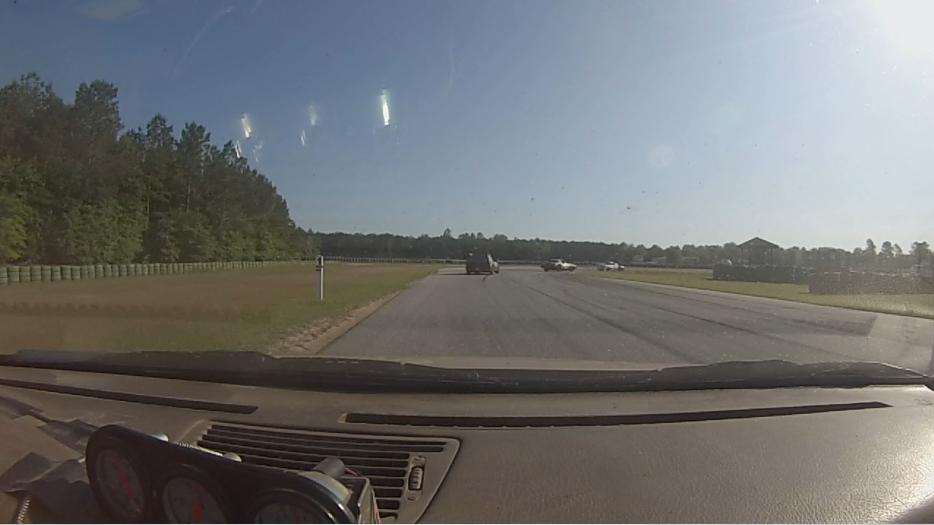
T14
Notes:
Pics of the turns. You should be able to cover this in the video, but just in case, here are some still pics.
22

Slide 23
Something to Check Out:
Search for the iRacing Driver School on YouTube.
Notes:
Pics of the turns. You should be able to cover this in the video, but just in case, here are some still pics.
23

Slide 24
Final Words
Everybody understand?
Be safe, have fun
Any questions?
Next class: 12:00
Notes:
24

Slide 25

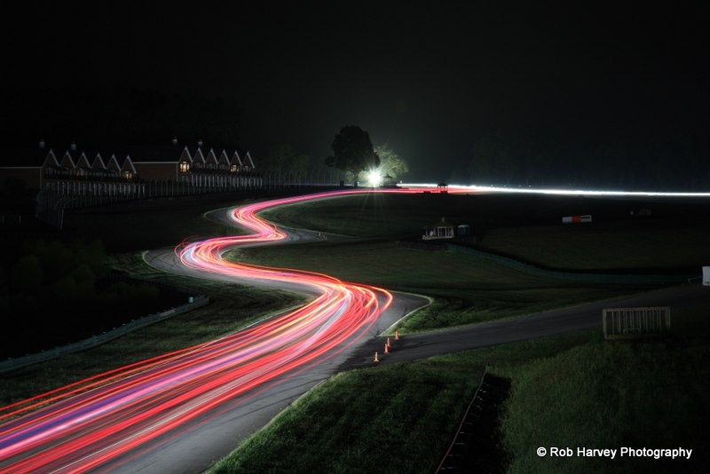












Thank You Sponsors!

