Slide 1

Roger McDaniels
Session 1 – Advanced Group

Slide 2
Weekend Classroom Agenda
Session 1
Rules/Goals
Session 2
Managing Weight Transfer
Session 3
Visual Cues
Session 4
On track exercise introduction
Session 5
On track exercise review/Car Modifications
Session 6
Performance Analysis Tools
Notes:
2

Slide 3
Club Rules
HPDE, NOT OPEN TRACK OR RACING
TWO OFF RULE
OFFS OR SPINS
MECHANICAL BREAK-DOWNS
Notes:
This session is for green students. If you aren’t in green, you are welcome to stay but I ask that you hold your questions for the classroom session for your color as you will get more level appropriate answers.
Now, some required content.
HPDE, NOT OPEN TRACK OR RACING – Aggressive driving will be closely monitored. Event stewards are in constant communication with corner workers and will utilize black flags to ensure everyone’s safety on track.
TWO OFF RULE –THSCC has always had a two-off rule. This means that two ‘loss-of control’ incidents in one day warrants us ‘parking’ you for the rest of the day. If circumstances warrant, we reserve the right to park you for the weekend. This does not include doing the right thing when you get in over your head by driving straight off track, in a controlled manner, safely and re-entering the track safely.
OFFS OR SPINS – Crisis management is one of the 1st things you’ll have to learn on track. Should you find yourself ‘in over your head’, your first priority is to come to a controlled and safe stop. If possible, drive straight off and bring the car to a controlled stop, preferably in view of a corner worker station. Wait for the corner worker’s indication that it is safe to re-enter the track. If you find yourself out of control, go both-feet-in (clutch in, brake in). Do not try to ‘save’ the car – it will generally lead to the exact opposite effect. After any loss of control (on or off-track), or ‘four wheels off’, you must pit in and let the grid marshal check your vehicle over for any safety issues. He will also make sure You are OK; he will then let you back on track. Failure to pit in will result in a black flag and an extended debriefing.
MECHANICAL BREAK-DOWNS – if your car has a mechanical issue that has severely slowed you down, drive off-line and display the pit-in signal (raised fist high above the driver’s window) and proceed to pit-in. If you cannot proceed, pull off the track, off line, and in view of a manned worker station if possible. Stay in your car. If you are out of the way, you’ll probably have to wait for the end of the session. If you are in a dangerous position, we will black flag the session to get you out of the way, and then proceed as time allows. If you encounter a disabled car, displaying the pit-in signal, and clearly off-speed, it is OK to pass that car.

Slide 4
Balancing Classroom and In Car
Control and command. No matter what I say here, in car do what he/she says.
Always alert your in-car instructor to anything you are going to do based on what is taught here or any fantastic idea that pops in to your pretty little head.
If you have a problem or disagreement with your instructor, talk to him/her first.
Notes:
Helmsman is in control, Captain is in command.
If he says don’t do that, don’t do it. No ifs. No ands. No buts. And especially no “but Rich saids.”
No surprises. I will try to convey anything I want you all to try, but you should do it individually.
Communication at speed can be very difficult and on track when your adrenaline is pumping, misunderstanding can happen quite easily. Talk about it in the paddock.
I will defer to your in car instructor for specifics. I am happy to provide my perspective, but I cannot see, hear or feel what is happening in the car so I am not going to be able to give as good advice.

Slide 5
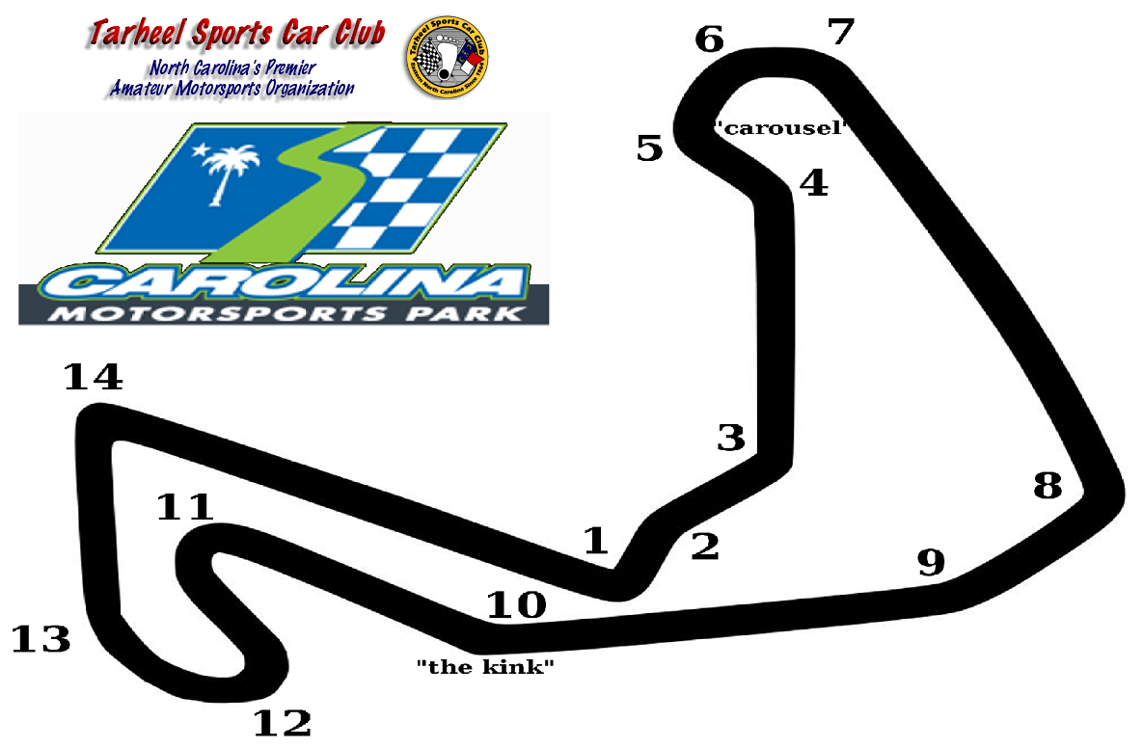
Right
Left
Left
Right
Right
Right
Left
Thanks Chris Brown
Notes:
Make sure passes are completed BEFORE the kink.

Slide 6
Why Are You Here?
Precise, Consistent, Smooth
Improve Control
Increase Consistency
Safety
Fun
Speed
Notes:
Ask, get some answers. Hopefully they are here to drive fast. Tie other answers in to drive fast, emphasize that precise/consistent/smooth are keys to safe/fun/fast and that there is a path which we will help them make progress on.
6

Slide 7
Goals for this weekend?
Why have weekend goals?
Measurable Success
Motivation
Increased long term success rate
Direction
You paid for this, get the most out of it!
Instructor will be more effective with goals
You will improve faster with goals
Notes:
Ask, get answers, make them get specific. Drill down if they give generic goals.
Stress importance of specific short term goals
7

Slide 8
Characteristics of Productive Goals
Specific
The more specific, the better
Attainable
Preferably this weekend, we only rented the track for the weekend
Measurable/Observable
Includes observable by your instructor, who may be able to help you set some goals based on their observations, maybe something you should ask them about………………………
Notes:
Level of the intermediate student should be one who is self-aware
8

Slide 9
What do you want to work on?
Could be a technique or timing issue (turn-in)
Could be a track feature (T1)
Pick 1-3 things and discuss them with your instructor
Notes:
Ask, get specific examples, but don’t push too hard.
9

Slide 10
Final Words
Take your goals to your instructor
Be safe, have fun
Any questions?
Next class: 12:00
Notes:
10

Slide 11

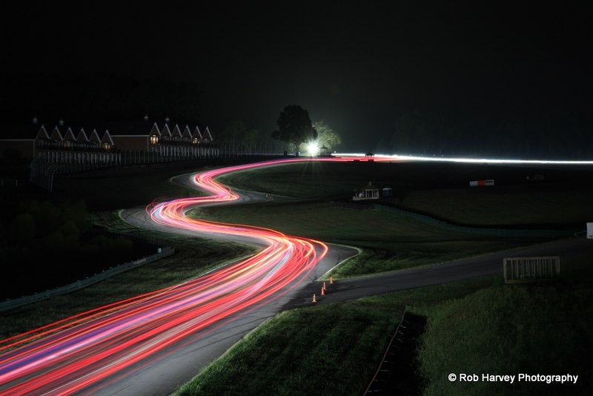












Thank You Sponsors!

