Slide 1

Data Analysis 1
Roger McDaniels

Slide 2
Performance Analysis Tools
Video
You can review your performance when you are not trying to focus on driving
You will see things that you don’t see while driving
Others can provide feedback
Data Logging
Analyze performance at specific track features
Compare different lines, different laps, different drivers
Try a different line and know how much you gain or lose from it
Know what actually is faster instead of what feels faster
Notes:
2

Slide 3
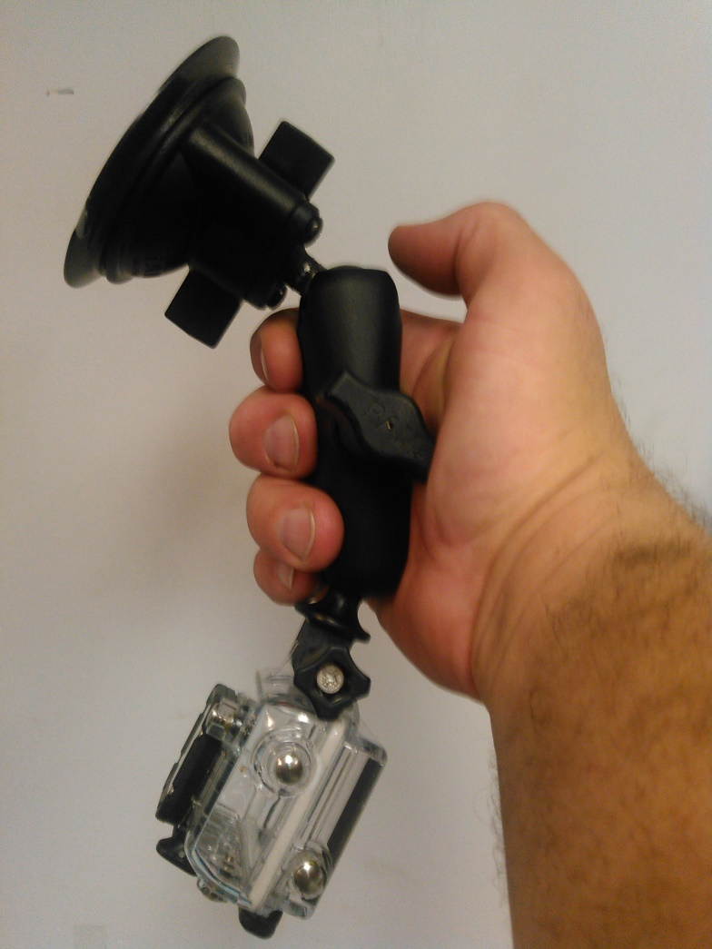
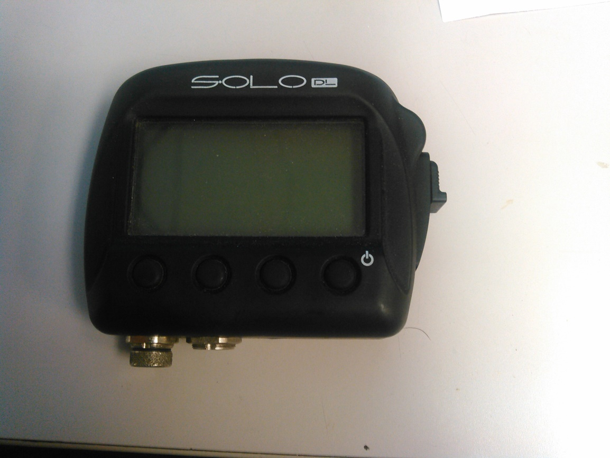
My Performance Analysis Tools
Notes:
3

Slide 4
Logging and stuff we can log
Speed
RPM
Lat/Lon G-Force
Throttle
Steering

Slide 5
Speed – 80%
Identify Corners/Straights
Braking Points
Braking Effort
Throttle/Lift
Driving Lines

Slide 6
The Speed Distance Line
Analysis Demo
VIR T1 – Me
Me vs. Robert, Stag, T1-T4
VIR Me Vs. Charles

Slide 7


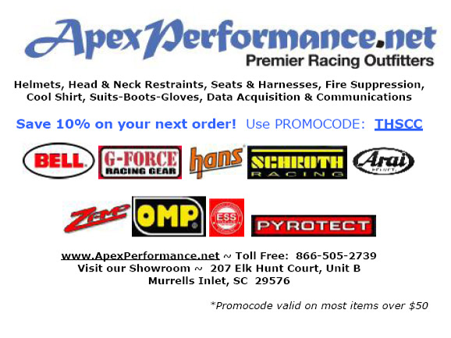












Thank You Sponsors!

