Slide 1

Exercise: Top Gear
Roger McDaniels

Slide 2



Noise ≠ Speed
VIR-N T2, I am in 3rd gear and it has actually resulted in me being significantly faster, right up until I have to shift to 4th and I lose all of my extra speed plus a whole lot more while Kraig keeps his foot on the floor in 4th gear and passes me. I was actually in the lead up until this point, but this was where Kraig passed me and I would not catch him.
VIR-N T5A, I am in 3rd and Kraig is in 4th, same story; I start slightly faster and lose it all and more shifting to 4th. You may notice that I skipped T4; I was in 2nd there and lost almost twice as many MPH as I did at T5A; it was ugly.
T10, same story. I figured going uphill easily justified the lower gear. I was wrong.
Notes:
Top graph is speed, bottom graph is relative track position. This was Kraig and me, same car, same day.
2

Slide 3
On Track Exercise
Anyone signed off?
If your instructor is in the car, then tell them about this, preferable well before you try it.
You are going to be working on improving your smoothness and vision
Focus on conservation of momentum
Work on improving corner entry speed
Keep your eyes up, way up, more than you normally would; you want to be looking all the way through each turn before you enter it.
Notes:
3

Slide 4
On Track Exercise - Mechanics
You will go out as normal
After you get up to speed, whatever the lowest gear that you would normally use on track during a normal lap is, stop using that gear. Only use the gears above it.
That is all
Notes:
4

Slide 5
On Track Exercises - Notes
If you let your speed drop too low, then it will take forever to get back up to speed. That sucks, but it’s the point of the exercise. It’s like movie with the bus, but your car doesn’t explode, hopefully.
If you drive a car with a supercharged V8 with 8000 lb/ft of torque, then you may not notice the difference. This just isn’t your exercise.
If you drive a car with an automatic transmission, then this exercise isn’t for you, just drive normally and laugh at your struggling group as you pass them repeatedly.
Notes:
5

Slide 6
On Track Exercises - Notes
If you are trail braking effectively, then this will be much easier for you. If you are not, then it may be time to start working on that.
This is voluntary. If you are not having fun with it, then don’t do it. I have done this for hours (because my clutch was broken during an endurance race), and it changed my life. I gained the ability to read Sanskrit and to project my consciousness at will through time and space. You can get out of this what you put in to it, much like anything else.
Notes:
6

Slide 7
Final Words
Everybody understand?
Be safe, have fun
Any questions?
Notes:
7

Slide 8

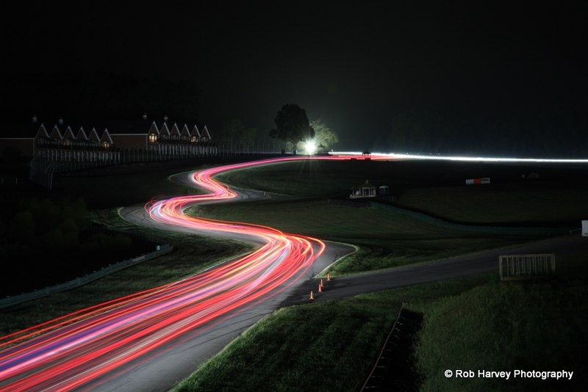












Thank You Sponsors!

