Slide 1

Green First Session Info
Roger McDaniels

Slide 2
Club Rules
HPDE, NOT OPEN TRACK OR RACING
TWO OFF RULE
OFFS OR SPINS
MECHANICAL BREAK-DOWNS
Notes:
This session is for green students. If you aren’t in green, you are welcome to stay but I ask that you hold your questions for the classroom session for your color as you will get more level appropriate answers.
Now, some required content.
HPDE, NOT OPEN TRACK OR RACING – Aggressive driving will be closely monitored. Event stewards are in constant communication with corner workers and will utilize black flags to ensure everyone’s safety on track.
TWO OFF RULE –THSCC has always had a two-off rule. This means that two ‘loss-of control’ incidents in one day warrants us ‘parking’ you for the rest of the day. If circumstances warrant, we reserve the right to park you for the weekend. This does not include doing the right thing when you get in over your head by driving straight off track, in a controlled manner, safely and re-entering the track safely.
OFFS OR SPINS – Crisis management is one of the 1st things you’ll have to learn on track. Should you find yourself ‘in over your head’, your first priority is to come to a controlled and safe stop. If possible, drive straight off and bring the car to a controlled stop, preferably in view of a corner worker station. Wait for the corner worker’s indication that it is safe to re-enter the track. If you find yourself out of control, go both-feet-in (clutch in, brake in). Do not try to ‘save’ the car – it will generally lead to the exact opposite effect. After any loss of control (on or off-track), or ‘four wheels off’, you must pit in and let the grid marshal check your vehicle over for any safety issues. He will also make sure You are OK; he will then let you back on track. Failure to pit in will result in a black flag and an extended debriefing.
MECHANICAL BREAK-DOWNS – if your car has a mechanical issue that has severely slowed you down, drive off-line and display the pit-in signal (raised fist high above the driver’s window) and proceed to pit-in. If you cannot proceed, pull off the track, off line, and in view of a manned worker station if possible. Stay in your car. If you are out of the way, you’ll probably have to wait for the end of the session. If you are in a dangerous position, we will black flag the session to get you out of the way, and then proceed as time allows. If you encounter a disabled car, displaying the pit-in signal, and clearly off-speed, it is OK to pass that car.

Slide 3
Balancing Classroom and In Car
Control and command. No matter what I say here, in car do what he/she says.
Always alert your in-car instructor to anything you are going to do based on what is taught here or any fantastic idea that pops in to your pretty little head.
If you have a problem or disagreement with your instructor, talk to him/her first.
Notes:
Helmsman is in control, Captain is in command.
If he says don’t do that, don’t do it. No ifs. No ands. No buts. And especially no “but Rich saids.”
No surprises. I will try to convey anything I want you all to try, but you should do it individually.
Communication at speed can be very difficult and on track when your adrenaline is pumping, misunderstanding can happen quite easily. Talk about it in the paddock.
I will defer to your in car instructor for specifics. I am happy to provide my perspective, but I cannot see, hear or feel what is happening in the car so I am not going to be able to give as good advice.

Slide 4
Safety
Goal number 1 for everyone here is a safe event
The corner workers and their flags are essential to your safety
On the first lap of every session, point out each corner working station to your instructor
On the last lap of every session, wave “thank you” to each corner working station
Notes:
Go home in the car you came with, in the same condition. Maybe a little worn, but no damage.

Slide 5





Flags
Notes:
Participation flag review.
What it means and what to do.
A Standing Yellow flag (not the one on the warm up laps) means “something has happened ahead, keep going but be on the lookout for what the flag was shown for. Maybe a car went off and is sitting (off the track) waiting to come back on. No passing is allowed on any yellow flag.
A Waiving Yellow flag means “something has happened immediately ahead that may require you to be ready to make a maneuver to avoid something. Like a car has spun, but is still on the pavement blocking the line. The more “animated” the corner worker is with this flag, the more serious the nature. It DOES NOT MEAN SLAM ON THE BRAKES !!!!!!!
The Debris flag means something is on the track, see it, avoid it. Pretty simple. It could be a part, or anti-freeze so keep you vision up.
The Black flag has several meanings. If you see a standing black flag at every station it means all cars back to the grid. If the corner worker points it at you (rolled) he may be giving you a hand signal to roll down the window, close the sunroof, etc. If he points it at you then waves it, come into the grid immediately. You may a mechanical issue that he has noticed or you may have been a bad …passing w/o a signal for example. BTW, ignoring any flag could possibly get you a quick trip home.
The Advisory Flag means “check your mirrors, there is a faster car that wants to pass”. - we will cover passing shortly
The White Flag is hardly ever used, but it means a slow moving vehicle…like a tow truck or maybe someone is trying to limp there car back into the pits. You are allowed to pass, but a t much lower rate of speed.
Red Flag - To every club I’ve been with it means “check your mirrors and come to a controlled stop”…on a level part on the RIGHT side of the track (stay on the pavement)….in view of a corner work is preferable. The reason you find a level spot…so you don’t have your foot on the brake. The brake pad can actually weld itself to the rotor if it’s hot and you do this. NEVER use the e-brake in this situation! If you can’t easily get to a level part of the track relatively quickly, stop and turn off the car, leaving it in gear, but again no foot on the brake or using the e-brake.

Slide 6

WINNER! WINNER! WINNER!
Notes:
Session is done. COOL DOWN.

Slide 7
Before Heading Out
Have the proper attitude
  You are here to learn.
  Check your ego at the door.
  Don’t worry about the color of the dot on your windshield.
  Being 'signed off' should not be viewed as a goal.
Set goals with your instructor
  Specific things you or he may want to do
Review terminology
Notes:
This driver education, not car education. Focus on your learning.
Check your ego at the door. There will be slower cars that go faster than you do. Don’t let it bother you, everyone starts at the bottom. This event is about you as a driver, not you as a car owner.
Don’t worry about the color of the dot on your windshield. Different people learn at different rates and each event has a different population so what the color means can change as well.
Being 'signed off' should not be viewed as a goal. Often it is just an extension of your instructor teaching you how to handle situations without being told how to do so. You paid for the instructor so learn everything he/she has to offer.
Setting goals
Attainable
Tangible
Review Terminology. Make sure you know what the other person means when they talk.

Slide 8
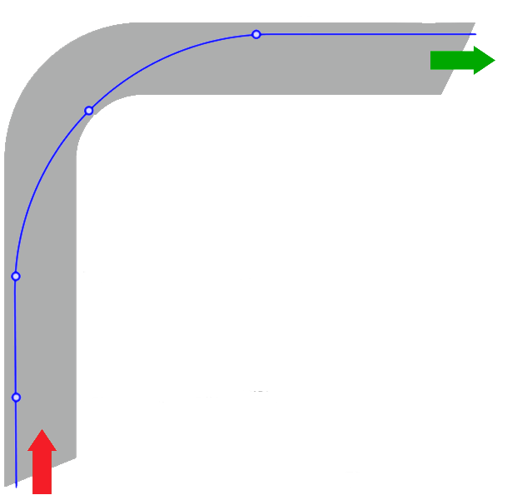
Terminology
Establish communications before
leaving the paddock!
Know the parts of a corner
  Braking zone
  Turn in
  Apex
  Track out
Review other inputs:
  Modulate? / Feather?
  Application? / Release?
  Earlier? / Later?
Track out
Finish wide
Apex
StartWide
Turn in
Brake in a
straight
line
Braking Zone
Notes:
None of these points are points, they are areas.
Ask if anyone has heard any other terms. Take questions.

Slide 9
Getting On Track
Check communication with instructor
Accelerate onto track
  No need to warm your tires
Proper merge procedure
  Stay full track left all the way through Turn 1
  Check your mirrors – NEVER ASSUME
Be careful in the first braking zone if you are using race pads
Point out all flag stations
Warm up the car and yourself
Notes:
And now, the moment you have all been waiting for…
Check communication with instructor – often things get pulled out in the last minute
Accelerate onto track – do so to create some space for yourself. No need to suck the fumes of the guy in front of you.
No need to warm your tires – going off line just picks up garbage
Proper merge procedure
Do not cross the line – do not swerve on to the track as soon as you pass the end of the line
Check your mirrors – NEVER ASSUME – even if you are first in line, check your mirrors before entering the racing line
Be carful in the first braking zone if you are using race pads
Point out all flag stations – call them out to your instructor
Warm up the car and yourself – do not try to go full speed on the out lap.

Slide 10
During the Session
Be courteous at all times
Notes:
Consider how what you will do will impact others on track
Passing
Driving off line (mental impact, dirt, marbles)
Your equipment (leaks, smells, etc.)
Following distance
Say thank you.

Slide 11
Passing
With passing signals, clarity is key
If you are being passed LIFT smoothly
Acknowledge the passing signal
Never pass when you aren’t ready
  You don’t have to take a passing signal
  Wave it off to avoid confusion
Notes:
Clarity is key
Passing signals should be clear
Nothing else that could look like a passing signal should be used
Know the pit in signal
One and only one signal per car
LIFT – your point by doesn’t give the guy behind you an extra 100 horsepower!
Acknowledgement
Don’t take a signal unless you are ready
Where and when to signal
As early as possible
The zones and the side.
The car making the pass will be off line for the next corner

Slide 12
Passing Signals – How To
Every car gets its own signal
A proper passing signal is a full arm motion
  Do not do the wrist point
Check your mirrors before the passing zone
Wave off
Thank you
Pit in

Slide 13
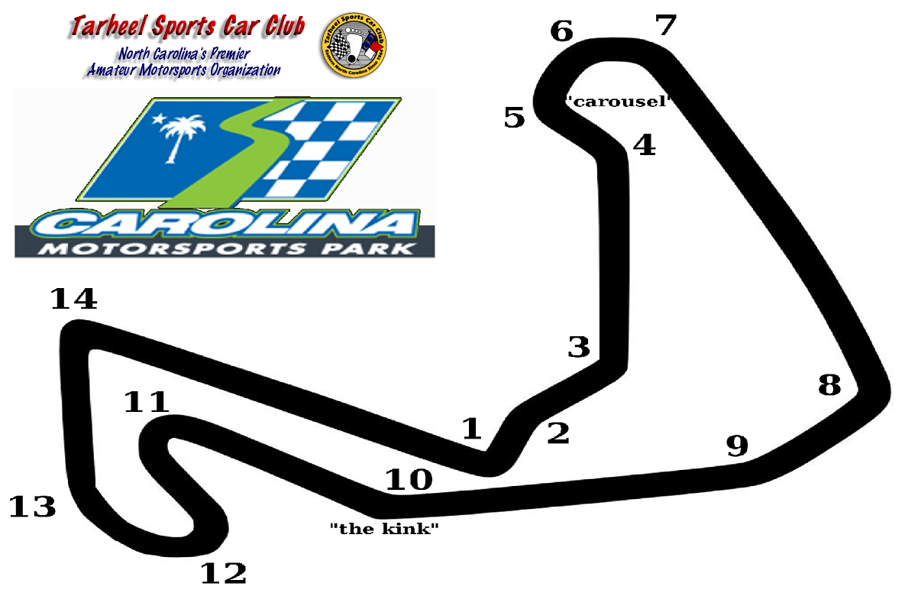
Right
Left
Left
Right
Right
Thanks Chris Brown
Notes:
Make sure passes are completed BEFORE the kink.

Slide 14
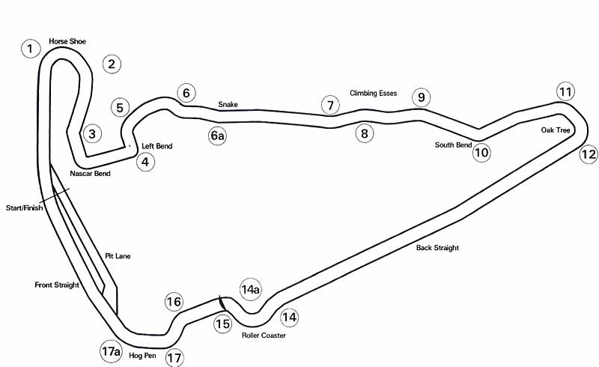

Yellow Passing Zones
Left
Left
Left
Right
Left
Right
Notes:
The passing zones.

Slide 15
Passing Signals – Other Notes
Use your instructor to help you
  Have him or her check your mirrors or
  Have him or her prompt you to check your mirrors in the appropriate places
Put mirror checks into your rhythm
Be aware of your body
  Keep the wheel straight
  Drive your line
The overtaking car is responsible for executing a safe pass

Slide 16

Notes:
Play “passing” movie.

Slide 17
Finishing the Session
Use your cool down lap
Wave to and thank the workers
If time permits, talk to your instructor in the paddock after the session
  Review your goals
  Review any learning moments
  Ask questions, share observations
Talk to those in your run group about anything that happened on track
Notes:
Use your cool down lap – your car will thank you. You can also see the track very well after a session since you brain is very focused. Look around on your cool down lap.
Thank the workers on and off track
Some instructors have back to back students, so this may not be possible
If you gave a bad passing sign, apologize. If you and someone else got confused talk to them.

Slide 18
Final Words
Be safe
Have fun
Any questions?
Next class: 12:00
Notes:
The next class is at just after lunch

Slide 19


