Slide 1

Improving Your Performance (With Brakes!)
Roger McDaniels
Notes:
Hello
1

Slide 2
Weekend Classroom Agenda
Session 1
  Introduction/Safety/Preparation/Passing
Session 2
  The Racing Line/Vision
Session 3
  Visual Cues
Session 4
  Crisis Management
Session 5
  Goals
Session 6
  Improvements

Slide 3
Improving Your Performance
It is always better to be a fast driver in a slow car than a slow driver in a fast car.
The most important thing that you can improve is the driver.
  Don’t let your modification plans impede your driver development
    Rain and hard tires punish bad behavior
    Fast cars can make you lazy
    Get the most out of your seat time
Notes:
When racing, I want the stickiest tires on the car that I can get. When learning, I want rock hard tires with too many heat cycles in them because they force me to be smooth if I want to be fast.
Are you just here to have fun? Do you want to improve? Either way is great, but I’ve found that this stuff is much more fun if you’re good at it.

Slide 4
Improving Your Car
Focus on things that make you a better driver
  Control
    Pedals/Steering wheel/Seats/Harnesses
Safety
  Roll Bar or Full Cage, HANS
Consistency
  Bushings, Shocks, Brakes
Reliability
  Oil Cooler, Gauges, Racing Fluids

Slide 5
What is a key difference between a good driver and a great driver?
How they use the brakes!
Notes:
Talk about Kraig taking a stint at VIR.
5

Slide 6
Getting the Most from Brakes
Learn the capability of your brakes
Always bed pads and rotors before coming to an event
Open spoke wheels
  Allow you to see your pads
  Helps brakes cool
Wear is not linear
Notes:
Cover bedding procedure
6

Slide 7
Brake Pad Wear

Slide 8

The Need for Cooling (Part 1)
Brakes function by converting energy (motion) into heat.
Notes:
Insert the Wilwood brake video

Slide 9
The Need for Cooling (Part 2)
Brake heat transfers through the system to all components.
The fluid is of particular concern.
  Fresh, high temp (aka racing) brake fluid has a maximum boiling point of about 600°F
  Brake fluid naturally attracts moisture which boils at just 212°
  This is why 100% fresh fluid is mandatory before each event
Notes:
Insert the Wilwood brake video

Slide 10
The Need for Cooling (Part 3)
Your brake pads work only within a specific temperature range.
Overheated pads wear faster
Thinner pads heat up faster
See how these relate?
Notes:
Pass out dead pad and piston

Slide 11
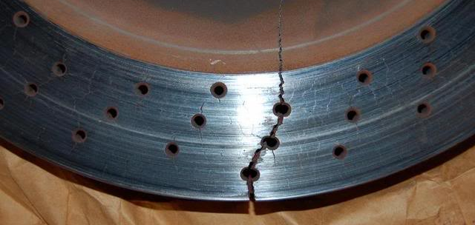
The Need for Cooling (Part 4)
Rotors are the system’s main heat sink
  There is a limit to how much heat they can take
  Slotted rotors can help with deposits
  Drilled rotors should generally be avoided
  When in doubt, add mass

Slide 12
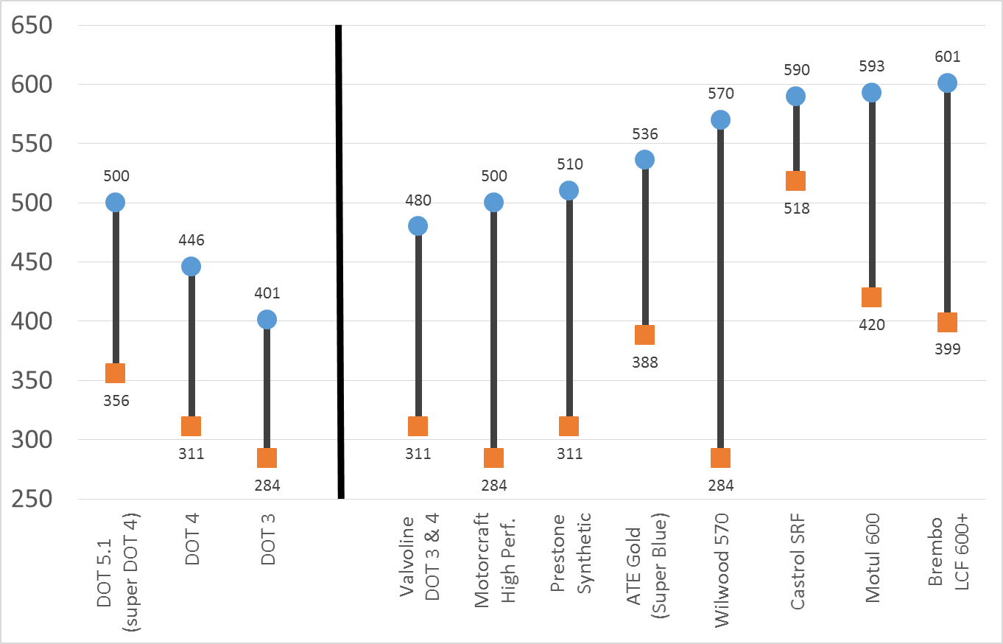
Why Fresh Fluid?

Slide 13
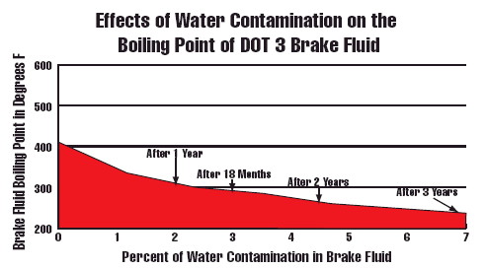
What Constitutes “Fresh”?
Brake fluid begins to absorb moisture (read degrade) immediately.
Notes:
Insert the Wilwood brake video

Slide 14
Improving Your Brakes
Brake upgrades should focus on durability, response and high temperature stability
Address the simple things first
  Fresh, high temp fluid for each event
  Select a pad that has a reputation for being smooth
  No pad can do it all; use one that is designed for the task at hand
  Teflon lined stainless steel lines can improve feel
  Inspect the pedal pivot for play

Slide 15

Brake Upgrades
#1: Dedicated Track Pads
Notes:
Will handle more heat.
15

Slide 16
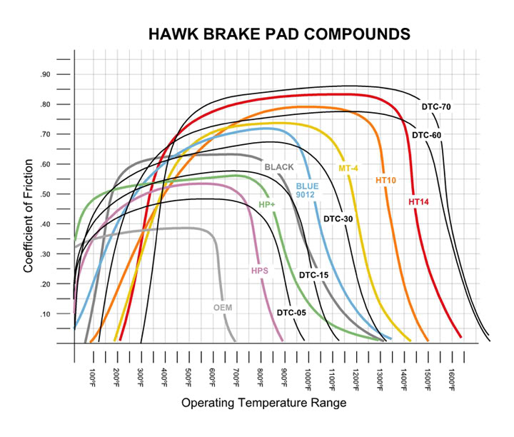
Pad Characteristics

Slide 17
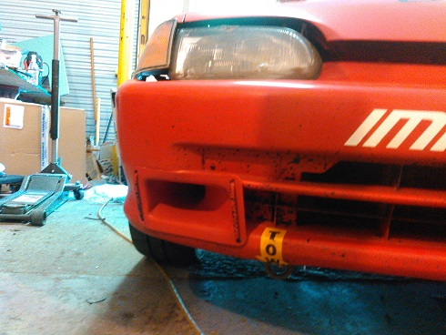
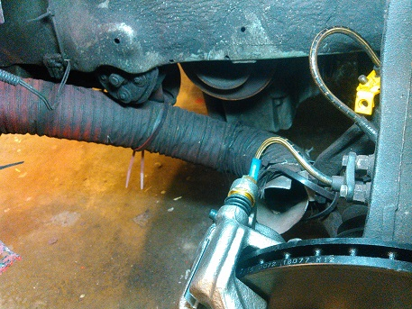
Brake Upgrades
#2: Air Ducting
Notes:
This cost less than $100
17

Slide 18
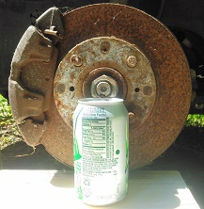
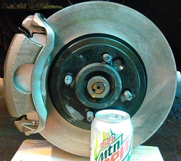
Brake Upgrades
#3: Bigger Brakes
Notes:
Talk about parts availability and pricing (Rock Auto!). Talk about high carbon rotors.
18

Slide 19
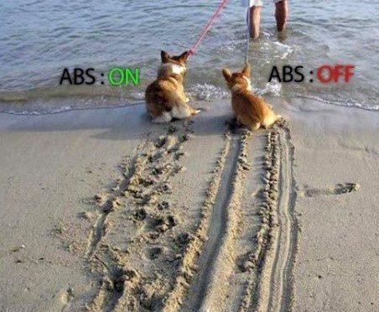
Before you Change Anything
Know What Your Car Has

Slide 20
Rev Matching Downshifts
(AKA Heel-Toe)
Notes:
They can work on this on the street. Demo with gaming pedals. Advise caution in traffic.

Slide 21














Thank You Sponsors!

