Slide 1

Vehicle Modification Discussion
Roger McDaniels

Slide 2
Car Modifications
This is more of a discussion than a lesson, so talk.
Ideas do not have to be realistic, we can learn from testing to infinity or zero.
What is our objective?
How important is my lap time?
What makes me better at this (or anything else)?
Racing is about winning. What is HPDE about?
Notes:
What if I could buy tires that had infinite traction?
What do I learn if I always succeed on the first try?
If failure is desirable, should we try to fail?
What if HPDE’s didn’t cost anything (including vehicle expenses)?
2

Slide 3
What result do we want and what modifications might help us get it?
Notes:
Reliability – Less Power, lower revs, oil cooler, gauges
Predictability – Bushings, shocks
Feedback – Tires, Springs
Challenge – Taping Windshield, not shifting
Cost – Cheap Parts and Tires
3

Slide 4
Final Words
Be smooth, look ahead
Be safe, have fun
Any questions?
Notes:
4

Slide 5

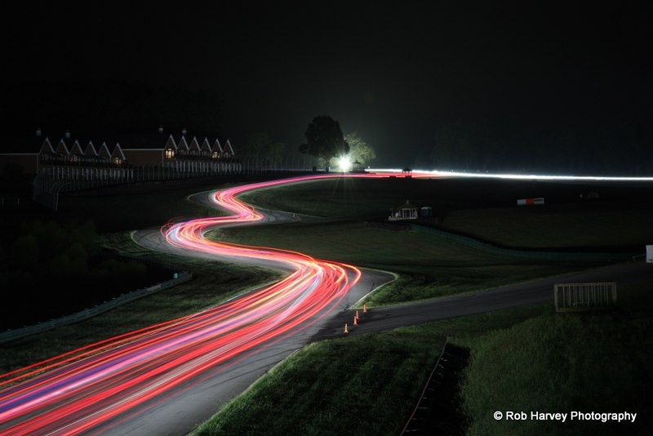


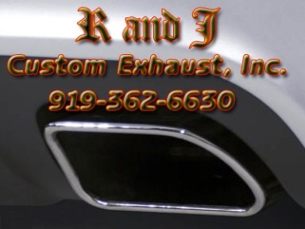





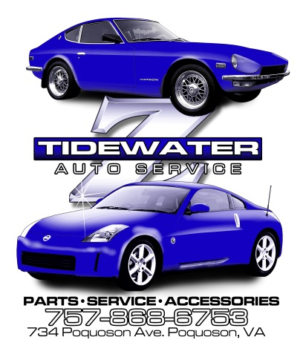



Thank You Sponsors!

