Slide 1

Vision
Roger McDaniels

Slide 2
Vision Is Essential
Vision
  You go where you look
  Always look ahead
  Soft eyes
    Don’t focus on one thing
    Scan the entire scene
  Use every opportunity to increase what you can see
    Ride with an instructor
    Go out during parade laps
Notes:
2

Slide 3
Vision
Where do you look when you are at
  Turn in?
  Apex?
  Track out?
  On the straights
Notes:
3

Slide 4
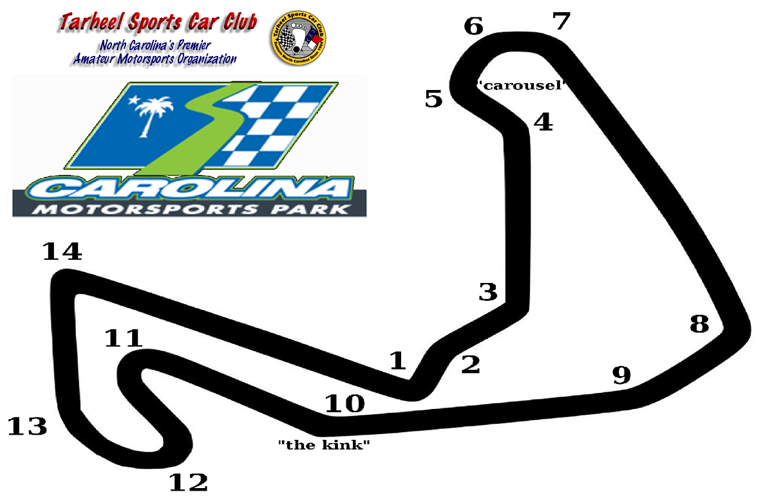
Training Your Vision 1
Notes:
Not teaching you this track. Teaching you track analysis.
4

Slide 5
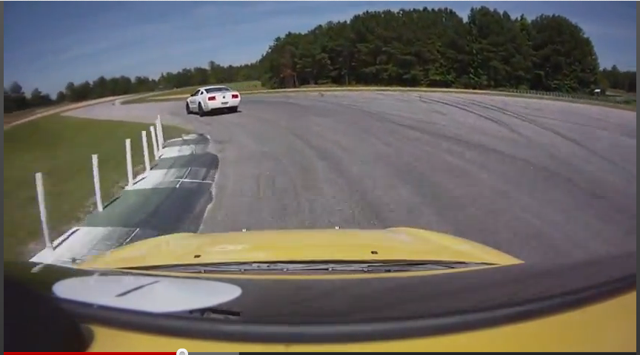
Notes:
5

Slide 7
Training Your Vision 2
Notes:
7

Slide 8
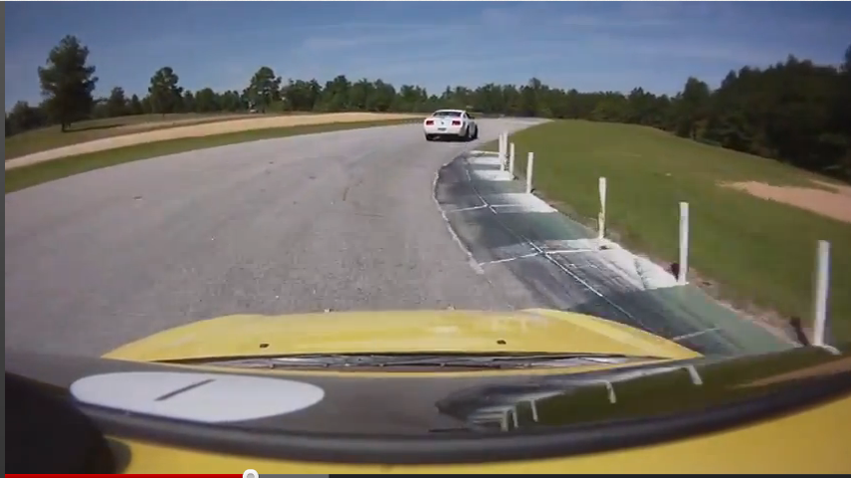
Notes:
8

Slide 10
Training Your Vision 3
Notes:
10

Slide 11
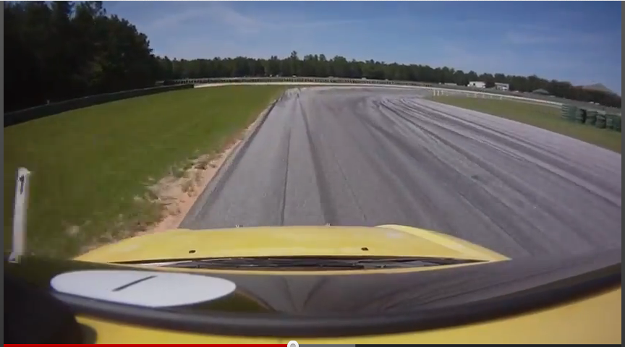
Notes:
11

Slide 12
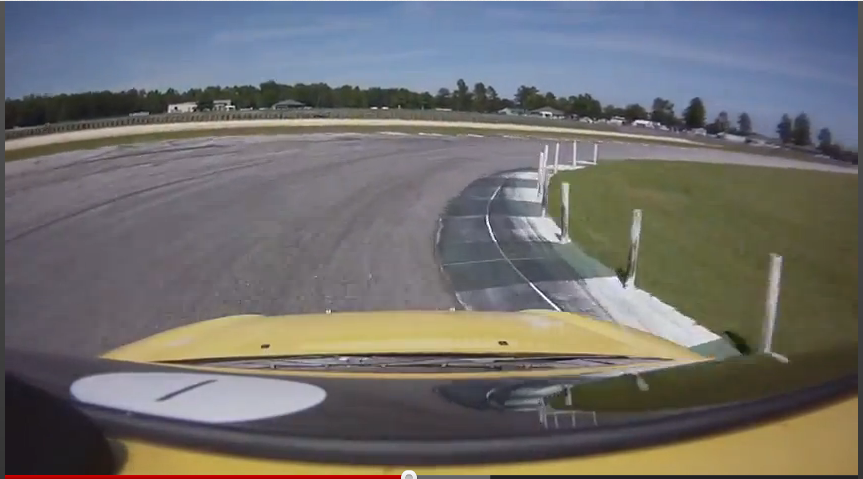
Notes:
12

Slide 14
Training Your Vision 4
Notes:
14

Slide 15
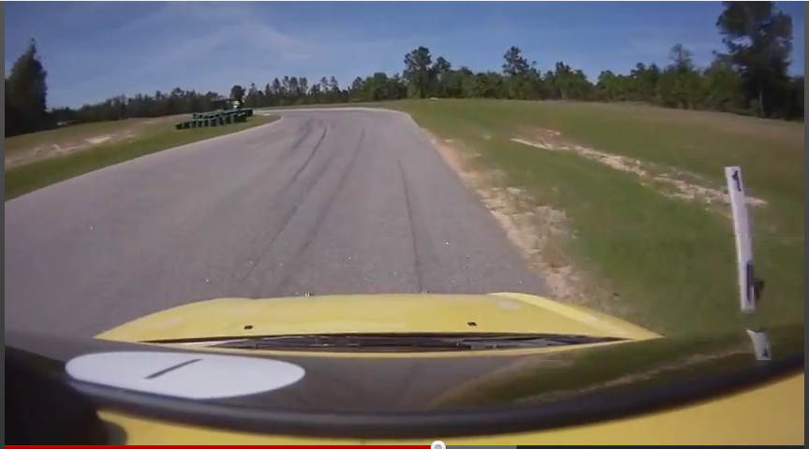
Notes:
15

Slide 16
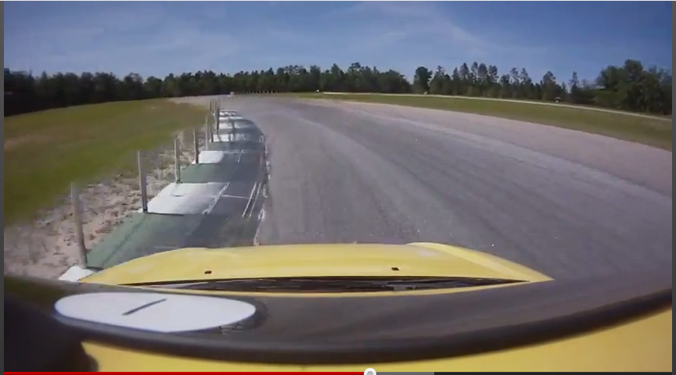
Notes:
16

Slide 17
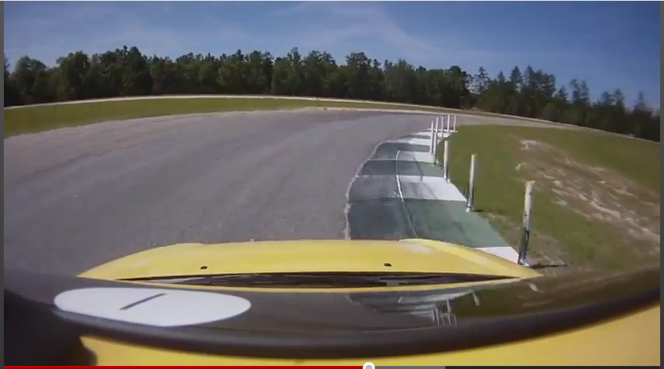
Notes:
17

Slide 18
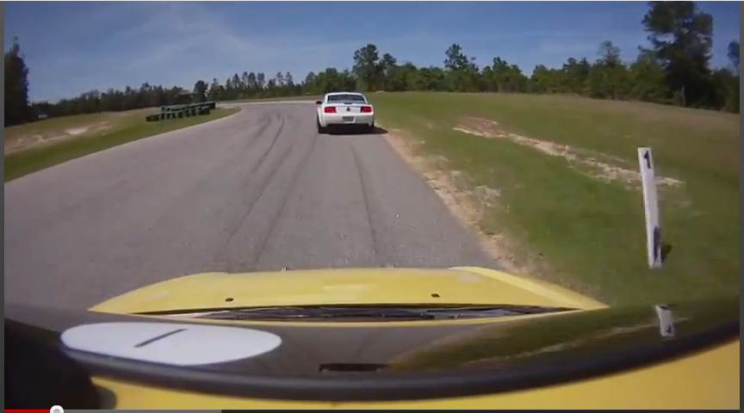
Notes:
18

Slide 19
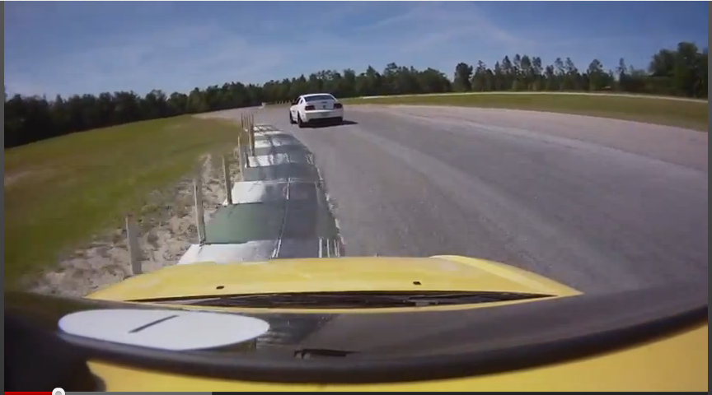
Notes:
19

Slide 20
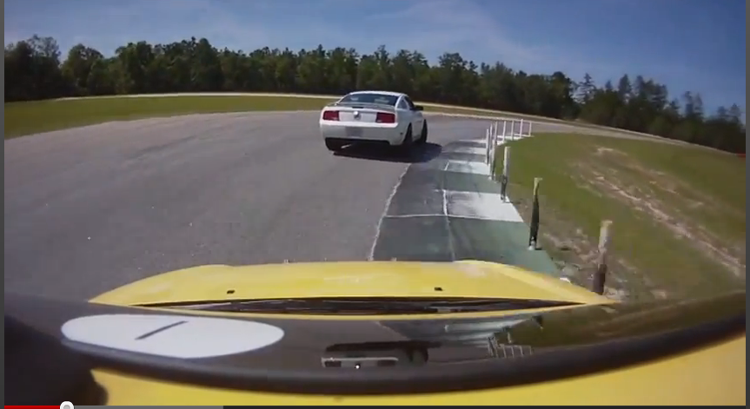
Notes:
20

Slide 22
Final Words
If you vision is right, everything else will follow
Be safe, have fun
Any questions?

