Slide 1

Roger McDaniels
Visualizing Performance

Slide 2
Time and Money: Do the Math
Track time is expensive and limited, make the most of it by using something cheap and plentiful, video.

Slide 3
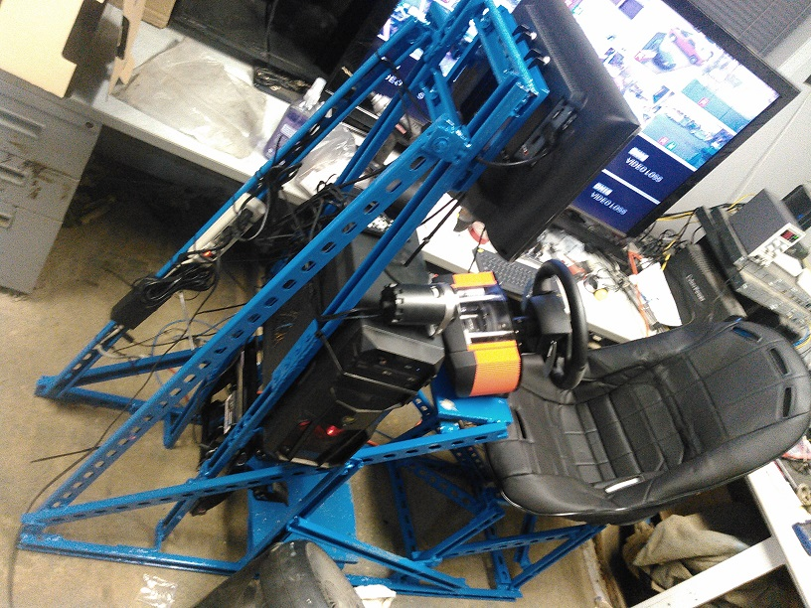
Go Crazy!!!
Notes:
3

Slide 4
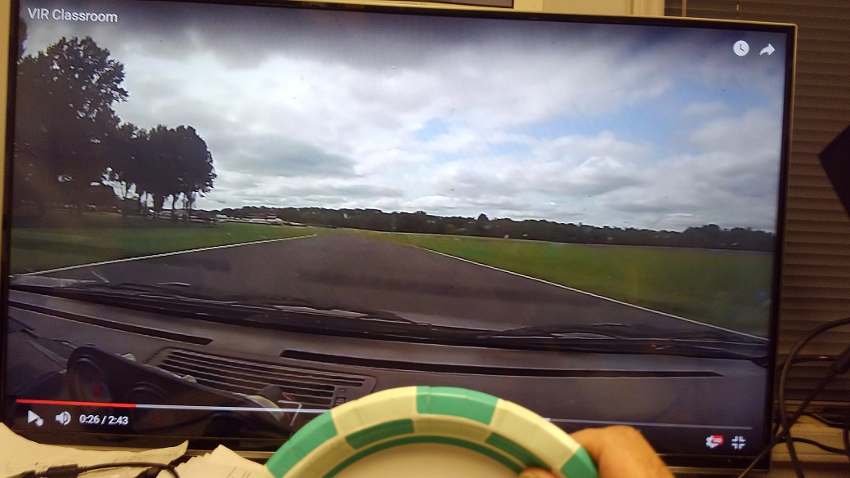
Or Go Cheap!!!
Notes:
4

Slide 5
How Much?
Until I can turn laps with my eyes closed 20-40 minutes/day for a week
Until I can correctly mark all corner worker stations on a blank track map from memory.

Slide 6

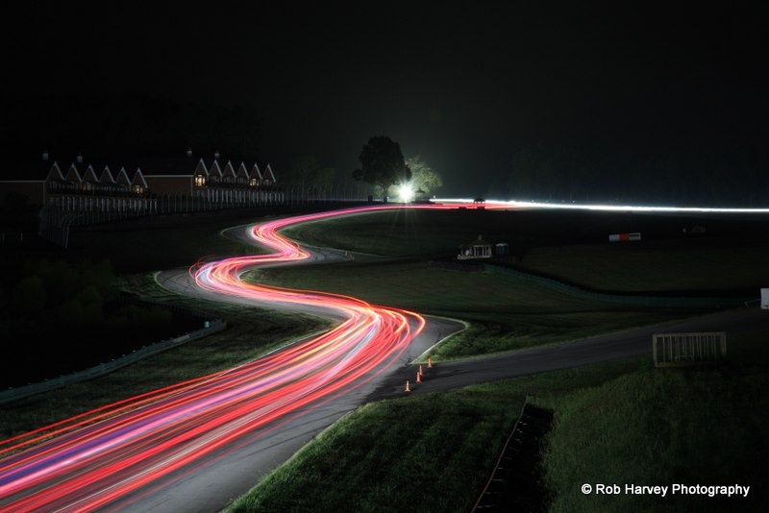












Thank You Sponsors!

