Slide 1

Roger McDaniels
Weight

Slide 2
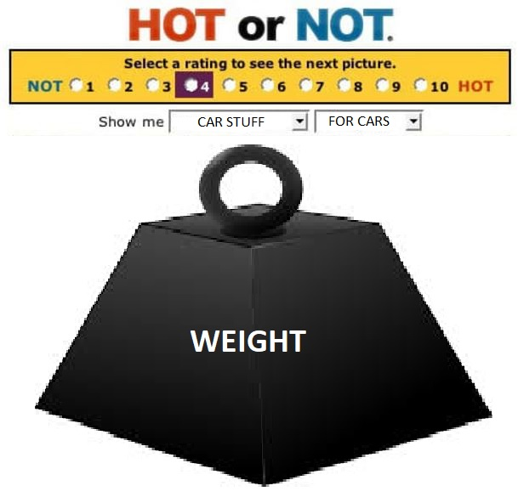
Notes:
Hot or NOT?

Slide 3
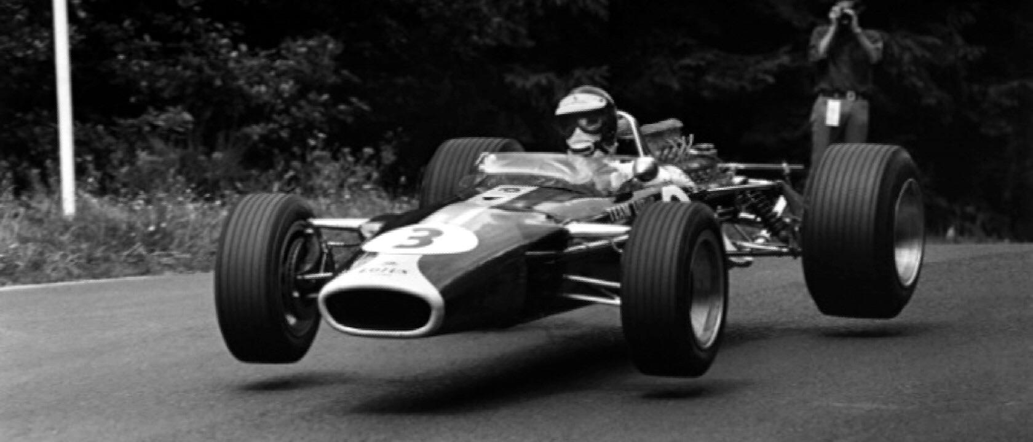
Notes:
Weight is not mass.

Slide 4
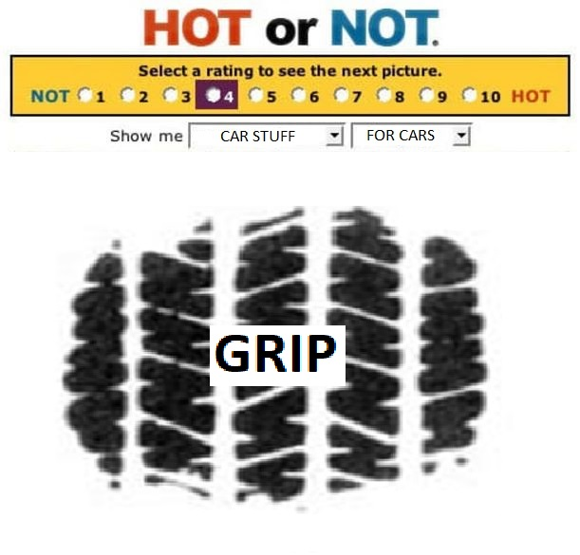
Notes:
Hot or NOT?

Slide 5
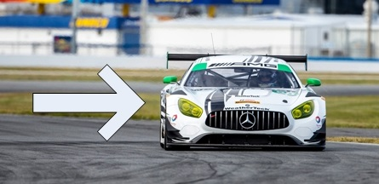
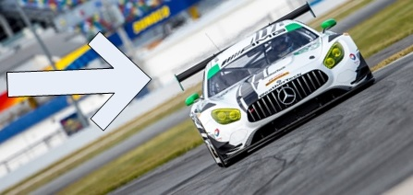
Camber Counts

Slide 6
DATA TIME!!!!!!!!!!!
Notes:
Run through a lap, talk about where this can be utilized and how it affects the line.

Slide 7
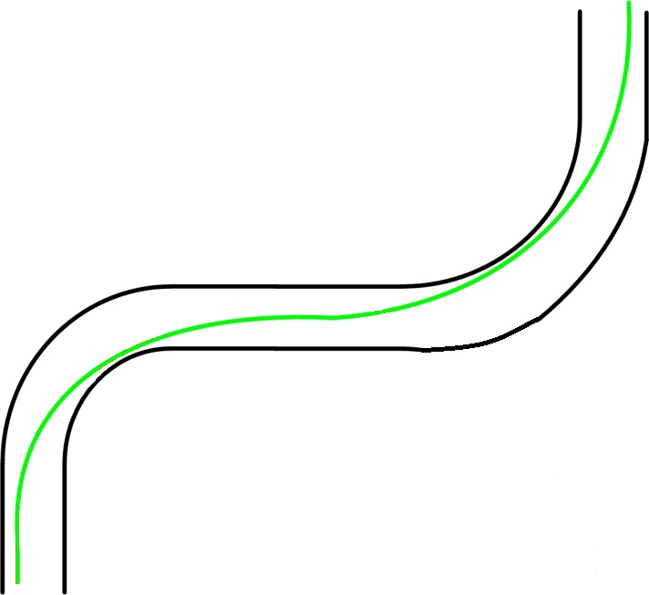
T14-T15
Notes:
Geometric line through 14-15, why or why not?

Slide 8
Final Words
Be safe, have fun
Any questions?
Notes:
8

Slide 9















Thank You Sponsors!

