Slide 1

Managing Weight Transfer (Oversteer and Understeer)
Roger McDaniels

Slide 2

GRIP
You have a finite amount of it, call it 100%
The more weight on a tire, the more grip it has
You can use it longitudinally (acceleration/braking)
You can use it laterally (turning)
If you are using 100% of your grip for braking, then you will not have it available for turning
“The steering wheel! It does nothing!”

Slide 3
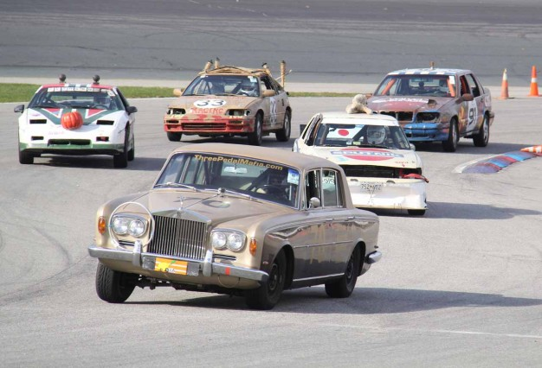
Weight Transfer
When accelerating, braking, or steering, the body of the car rotates in the opposite direction of the acceleration, braking, or steering, putting more weight on one side/end of the car and releasing weight from the other.
We will use weight transfer to manage which wheels we put weight on, in order to maximize the grip on the wheels that we need the most out of.

Slide 4

Acceleration
Transfers weight to the rear of the car
More weight on the rear tires= More Grip☺
Less weight on the front tires= Less Grip ☹
Advantages
Prevent oversteer in a FWD car (Why not RWD?)
Disadvantages
Can cause understeer
Notes:
Talk about ways to correct understeer (do less of that which is causing the understeer).

Slide 5
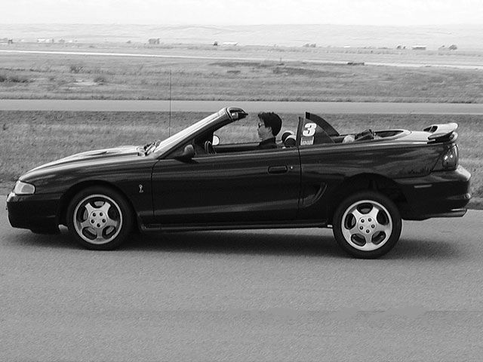
Deceleration
Transfers weight to the front of the car, usually more weight more suddenly because your brakes stop you much faster than your engine accelerates you
Brakes are more powerful for weight transfer than throttle
Advantages
Can prevent understeer (usually in the form of a lift)
Trail Braking, Throttle Lift Oversteer
Disavantage
Less traction at the rear wheeels (snap oversteer?)
Notes:
Talk about trail braking and corner entry speed.
Talk about a mid-turn lift to get the nose around.

Slide 6
Discussion Points
What causes understeer?
Driver?
Car?
Track?
What causes oversteer?
Driver?
Car?
Track?
Where can you explore understeer or oversteer?

Slide 7

Movie Time
Notes:
Play “oversteer and understeer” movie

Slide 8
Final Words
Observe understeer and oversteer during your next session
Be safe, have fun
Any questions?
Next class: 1:40
Notes:
8

Slide 9














Thank You Sponsors!

